Slide 1
Topic 08 Data Mining
ICT394 BI Application
Development

Slide 2
Resources
See Topic 08 Reading List in Moodle for links
REQUIRED:
Sharda Ramesh, Delen Dursun, and Turban Efraim. 2014. Business Intelligence and Analytics: Systems for Decision Support. Harlow: Pearson Education Limited.
There are a number of other links throughout the lecture slides and in the Topic reading list

Slide 3
Learning Outcomes
At the completion of this topic, you should be able to:
Define and give examples of data mining as an enabling technology for business intelligence and analytics
Understand and give examples of the objectives and benefits of data mining
Give examples of a wide range of data mining applications
Understand the standardised data mining process (CRISP-DM)
This topic contributes to the following unit learning outcomes:
Demonstrate an understanding of the role of BI in organisations
Present analyses of data using a number of different techniques

Slide 4
Lecture Outline
Data Mining Concepts
Data Mining Applications
Data Mining Processes
Data Mining Methods
Data Mining Software Tools
Data Mining Issues
Topic Summary

Slide 5
ICT394 Business Intelligence Application Development
Topic 08 Part 02:
Data Mining Concepts

Slide 6
Data Mining Defined
“…a process that uses statistical, mathematical and artificial intelligence techniques to extract and identify useful information ... from large sets of data.” Sharda et. al. (2014, p.222).
Also sometimes known as:
Knowledge extraction (KDD)
Pattern analysis
Data Archaeology
Information harvesting
Pattern searching
Data dredging

Slide 7
…another definition
“the nontrivial process of identifying valid, novel, potentially useful, and ultimately understandable patterns in data stored in structured databases”
Sharda, et al (2014, p.223)

Slide 8

Why bother?
Global competition
Untapped value of organisational data
Increasing consolidation of data
Vast improvements in processing and storage capabilities and reduction in cost
https://en.wikipedia.org/wiki/Recommender_system#The_Netflix_Prize

Slide 9
How data mining works
Four major types of patters:
Associations
Predictions
Clusters
Sequential Relationships

Slide 10
Data Mining Tasks
Sharda et al
(2014, p. 228)

Slide 11
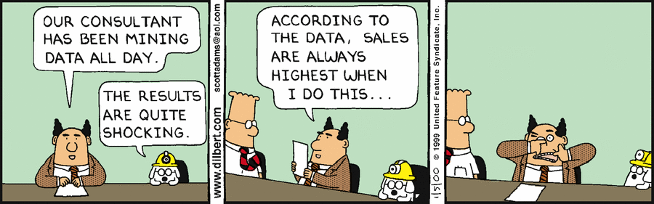
Where to from here…
Data Mining Applications
http://dilbert.com/strip/2000-01-05

Slide 12
ICT394 Business Intelligence Application Development
Topic 08 Part 03:
Data Mining Applications

Slide 13
Data Mining Applications
Data mining has been, and continues to be, used in a wide variety of contexts, some examples are:
Customer relationship management
Banking and other financial
Retailing/logistics
Insurance
Brokerage and securities trading
Manufacturing and Maintenance

Slide 14
CRM
Customer relationship management
http://searchcrm.techtarget.com/definition/CRM
Maximize return on marketing campaigns
Improve customer retention (churn analysis)
Maximize customer value (cross-, up-selling)
Identify and treat most valued customers

Slide 15
Banking and other financial
Automate the loan application process
Prediction of most likely defaulters
Detecting fraudulent transactions
https://www.youtube.com/watch?v=1zDwIfSDQiE
Maximize customer value (cross-, up-selling)
Optimizing cash reserves with forecasting

Slide 16

Retailing and logistics
Optimize inventory levels at different locations
Improve the store layout and sales promotions
Optimize logistics by predicting seasonal effects
Minimize losses due to limited shelf life
https://www.linkedin.com/pulse/20140403185417-4785379-diapers-and-beer

Slide 17
Manufacturing and maintenance
Predict/prevent machinery failures
http://www.manufacturing.net/article/2014/12/using-big-data-iot-predict-machine-failure
Identify anomalies in production systems to optimize the use manufacturing capacity
Discover novel patterns to improve product quality

Slide 18
Insurance
Forecast claim costs for better business planning
Determine optimal rate plans
Optimize marketing to specific customers
Identify and prevent fraudulent claim activities

Slide 19
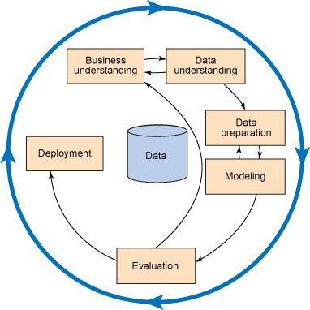
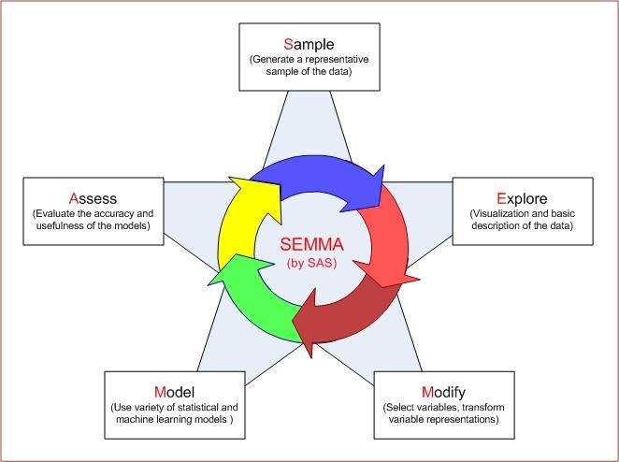
Where to from here…
Data Mining Process
http://sisbinus.blogspot.com.au/2014/11/processes-in-data-mining.html

Slide 20
ICT394 Business Intelligence Application Development
Topic 08 Part 04:
Data Mining Process

Slide 21
Data Mining Process
CRISP-DM

Slide 22
1. Business/Organisational Understanding
What is the study for?
Need for a thorough understanding of the need for new knowledge and an explicit specification of the objectives of the study

Slide 23
2. Data Understanding
Identify relevant data that is required to address the specific questions posed in the previous step
Obviously, the clearer the specification, the easier this step will be ☺
As we discussed earlier in the unit, we will need to understand where the data exist, what format they are in, how we access the data and so on
Will often be:
Demographic
Sociographic
Transactional

Slide 24
3. Data Preparation
AKA Data Pre-processing
Consolidation
Cleaning
Transformation
Reduction
Sharda et al (2014, p.237)

Slide 25
4. Modelling/Model Building
Representation of real-world observations
Applications of algorithms to see out, identify and display the patterns found in the data
Models, generally, with classify, predict or both
E.g., Decision tree are predictive in nature but can also be used to classify our data

Slide 26
5. Testing and Evaluation
Models are assessed and evaluated for their accuracy and generality
Particularly in terms of the business objectives of the project

Slide 27
6. Deployment
For the models generated to be of practical value, they must be deployed
The end users must be able to access and understand what the model shows
Could include preparation of a report, or some more sophisticated form of interactive system
Will also include maintenance
http://www.npr.org/sections/alltechconsidered/2012/10/31/163951263/the-night-a-computer-predicted-the-next-president

Slide 28
Where to from here…
Data mining methods

Slide 29
ICT394 Business Intelligence Application Development
Topic 08 Part 05:
Data Mining Methods

Slide 30
Classification
Most frequently used DM method
Part of the machine-learning family
Employ supervised learning
Learn from past data, classify new data
The output variable is categorical (nominal or ordinal) in nature

Slide 31
Classification Methodology
Two-step
Model development/training
Model testing/development

Slide 32
Classification Model Assessment
Predictive accuracy
Speed
Robustness
Scalability
Interpretability

Slide 33
Classification Techniques
Decision tree analysis
Statistical analysis
Neural networks
Case-based reasoning
Bayesian classifiers
Genetic algorithms

Slide 34
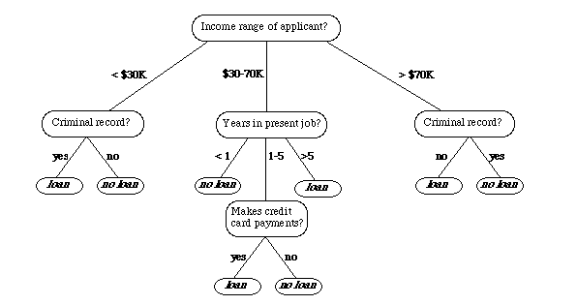
http://www.cse.unsw.edu.au/~billw/cs9414/notes/ml/06prop/id3/id3.html

Slide 35
Classification Techniques
Decision tree analysis
Statistical analysis
Neural networks: https://www.youtube.com/watch?v=bxe2T-V8XRs
Case-based reasoning: http://www.inf.ufsc.br/~awangenh/RP/RBC/introrbc.pdf
Bayesian classifiers
Genetic algorithms: http://www.obitko.com/tutorials/genetic-algorithms/

Slide 36
ICT394 Business Intelligence Application Development
Topic 08 Part 06:
Data Mining Software Tools

Slide 37
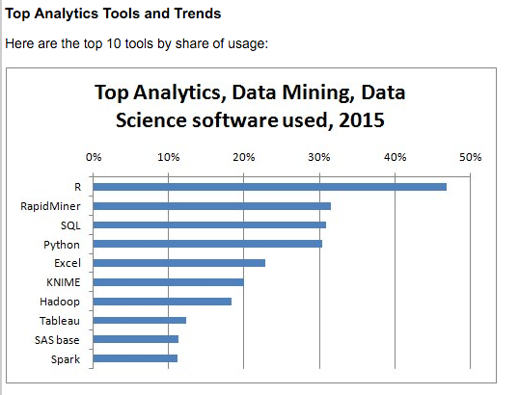
Data mining tool use
http://www.kdnuggets.com/polls/2015/analytics-data-mining-data-science-software-used.html

Slide 38
Some useful links…
Intro to Python for Data Science: https://www.datacamp.com/courses/intro-to-python-for-data-science
Other relevant “Data Camp” courses: https://www.datacamp.com/courses

Slide 39
ICT394 Business Intelligence Application Development
Topic 08 Part 07:
Data Mining Issues

Slide 40
Privacy issues
Any time that transactional data is stored, there may be identifying information
Name, address etc
Purchasing habits
Loan details etc
The ownership of that data is questionable
Data mining, uses these data

Slide 41
Myths…
Data mining …
provides instant solutions/predictions
is not yet viable for business applications
requires a separate, dedicated database
can only be done by those with advanced degrees
is only for large firms that have lots of customer data
is another name for the good-old statistics

Slide 42
Blunders
Selecting the wrong problem for data mining
Ignoring what your sponsor thinks data mining is and what it really can/cannot do
Not leaving insufficient time for data acquisition, selection and preparation
Looking only at aggregated results and not at individual records/predictions
Being sloppy about keeping track of the data mining procedure and results

Slide 43
ICT394 Business Intelligence Application Development
Topic 08 Part 08:
Topic Summary

Slide 44
Learning Outcomes
At the completion of this topic, you should be able to:
Define and give examples of data mining as an enabling technology for business intelligence and analytics
Understand and give examples of the objectives and benefits of data mining
Give examples of a wide range of data mining applications
Understand the standardised data mining process (CRISP-DM)
This topic contributes to the following unit learning outcomes:
Demonstrate an understanding of the role of BI in organisations
Present analyses of data using a number of different techniques

Slide 45
Lecture Outline
Data Mining Concepts
Data Mining Applications
Data Mining Processes
Data Mining Methods
Data Mining Software Tools
Data Mining Issues
Topic Summary

Slide 46
Where to from here…
Next topic:
Visualisation

